Slide 1
Decision Tree

Slide 2
Topics
White vs Black box models
Encoding Expert Knowledge
Knowledge acquisition problem
Attribute importance
Entropy
ID3 Algorithm
Gini
CART Algorithm
Non-parametric models
Regularization
Regression
Instability

Slide 3
White vs Black box models
Decision Tree:
versatile ML algorithms that can perform both classification and regression tasks
capable of fitting complex datasets
fundamental components of Random Forests
intuitive, and easy to interpret
Called white box models
provide nice, simple classification rules that can even be applied manually
In contrast, neural networks are generally considered black box models
make great predictions, but it is hard to explain why the predictions were made
Finding an "optimal" decision tree for a set of training data is computationally a very hard problem
we try to build a good-enough tree rather than an optimal one
it is very easy (and very bad) to build decision trees that are overfitted to the training data, and that don’t generalize well to unseen data

Slide 4

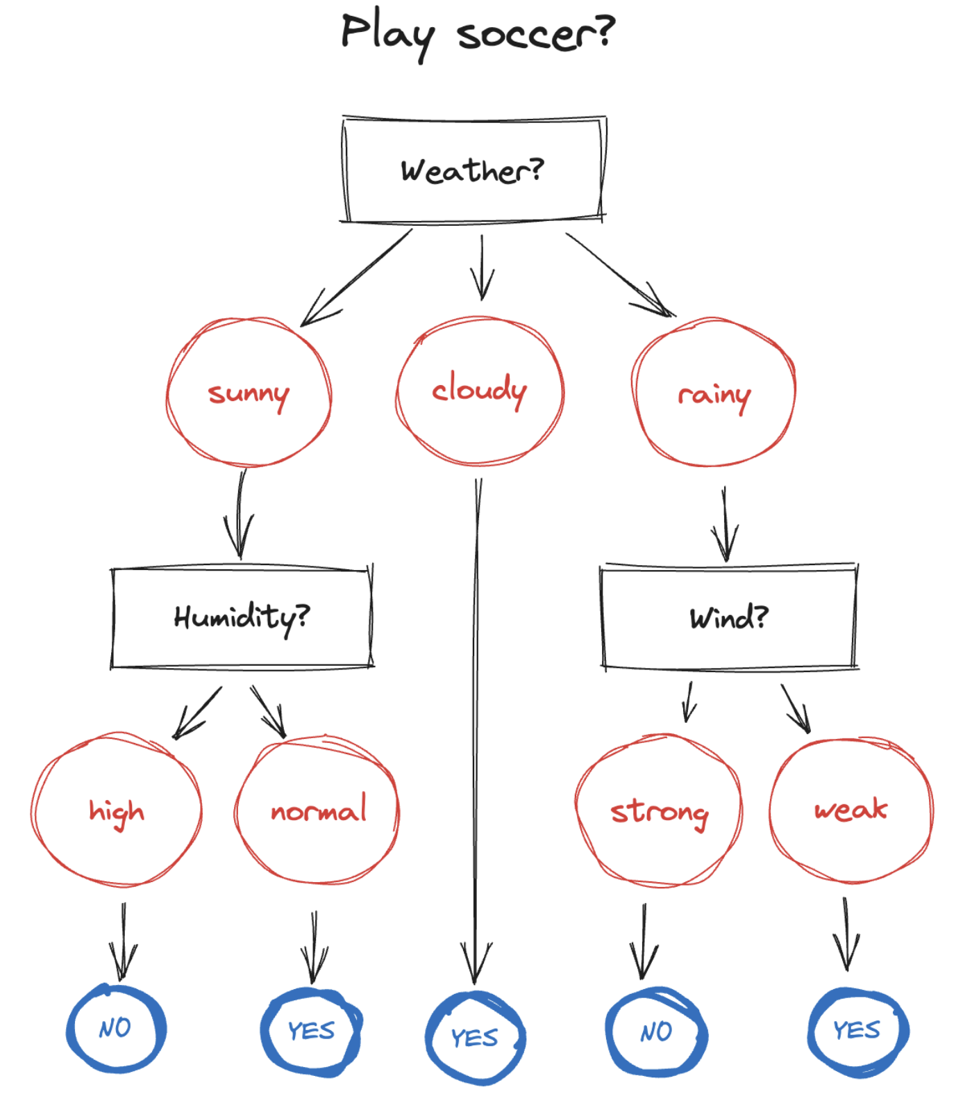
Definition
A tree structure to represent several possible decision paths and an outcome for each path
Suppose we want to decide if today we will play soccer or not
we start at the root node, it asks about weather
if it a sunny day, then we move down to the left child node
it asks for the humidity
if it is a normal day, the we move down to the next node
which is a leaf node
no other child nodes
it does not ask questions, it gives the answer
yes, we will play

Slide 5
Encoding Expert Knowledge (1)
We can encode the knowledge of an expert in a particular domain
For example, how to decide whether to wait for a table at a restaurant
in that case we are the experts
We need to identify the list of attributes that we consider as important to make the decision:
Alternate: whether there is an alternative restaurant nearby
Bar: whether the restaurant has a comfortable bar area to wait in
Fri/Sat: true on Fridays and Saturdays
Hungry: whether we are hungry
Patrons: how many people are in the restaurant (values are None, Some, and Full)
Raining: whether it is raining outside
Price: the restaurant's price range ( $, $$, $$$)
Reservation: whether we made a reservation
Type: the kind of restaurant (French, Italian, Thai, or burger)
WaitEstimate: the wait estimated by the host (0-10 minutes, 10-30, 30-60, or >60)

Slide 6
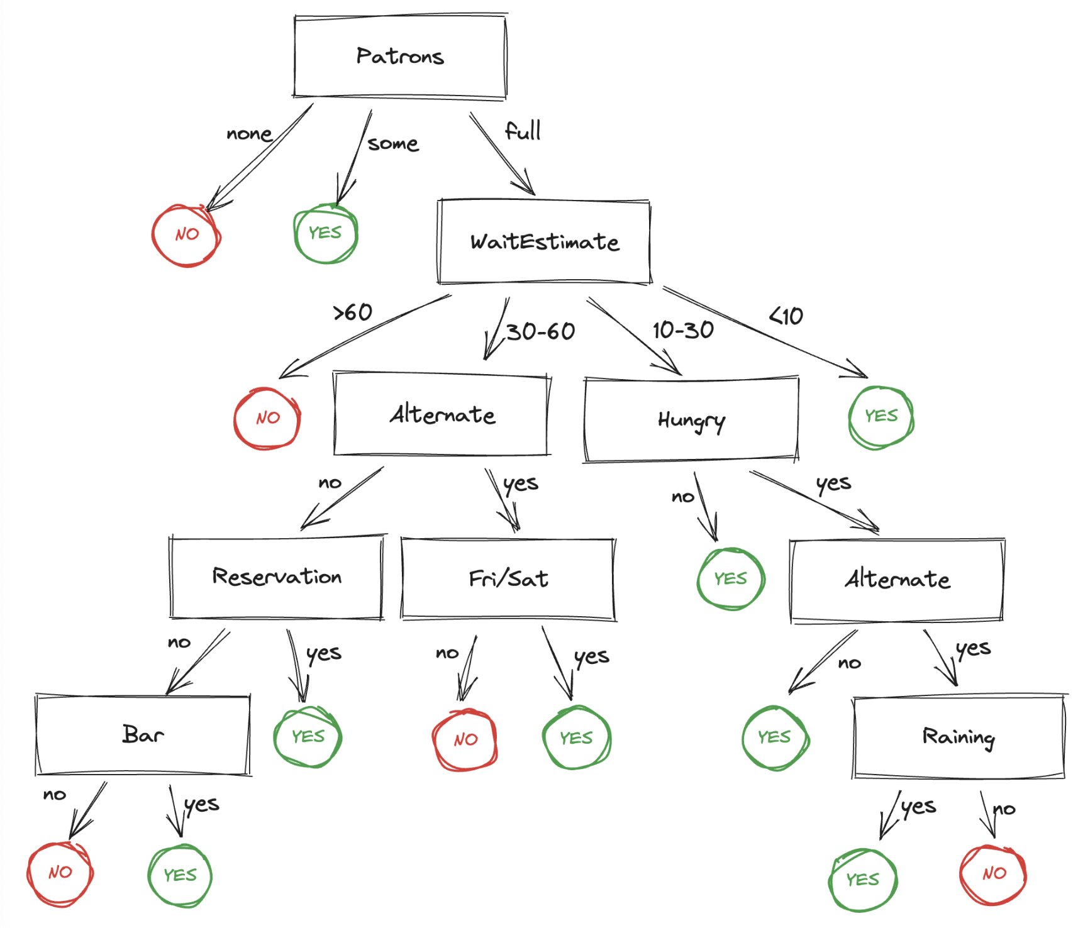
Encoding Expert Knowledge (2)

Slide 7
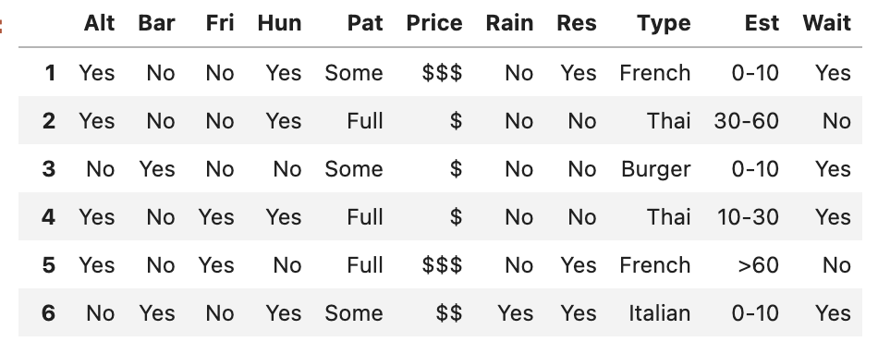
Knowledge acquisition problem (1)
Designing, debugging, and maintaining rules defined by experts is difficult and, in some cases, impossible
Knowledge possessed by experts is complex as most of it is tacit
cannot be captured without converting tacit knowledge to explicit knowledge (externalization)
What we can have instead is a dataset with examples
that we can leverage to find rules
For example, a list of past decisions that we made in different situations
an example consists of an (X, y) pair
X is a vector of values for the attributes
y is a single boolean output value

Slide 8
Knowledge acquisition problem (2)
How can we devise a Decision Tree from the set of examples?
Intuitively:
we must create a tree consistent with the examples
as small as possible
this is an intractable problem (NP-Complete problem)
we can find a good approximate solution
Divide-and-conquer Strategy:
test the "most important attribute"
the one that makes the most difference to the classification
divide the problem into smaller sub-problems and
solve recursively

Slide 9
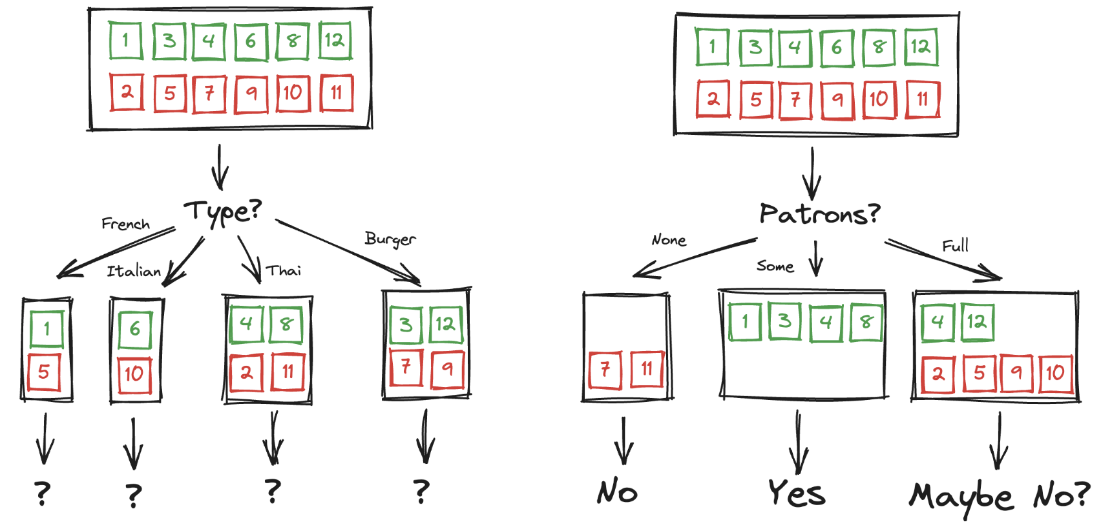
Attribute importance
Consider "Type" and "Patrons" in the toy example
Type is a poor attribute
four possible outcomes, each has the same number of positive as negative examples
Patron is an important attribute
if its value is None or Some, we have only examples we can answer definitively
if its value is Full, we have a mixed set of examples
Each outcome is a new learning problem: fewer examples, one less attribute
In choosing an attribute, we need a formal measure of "importance"

Slide 10
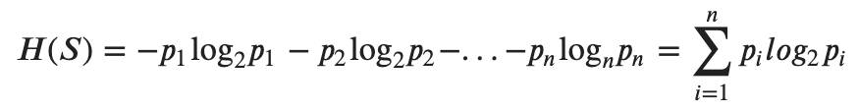
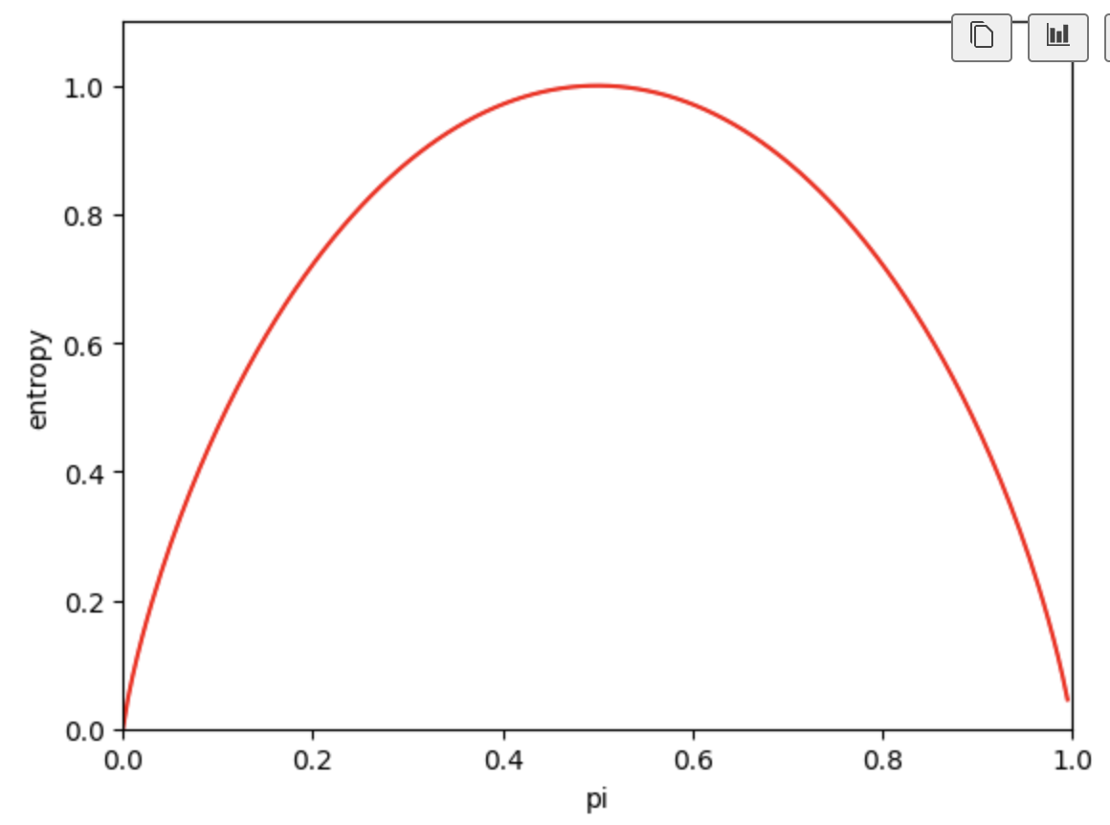
Entropy (1)
From Shannon’s information theory, to capture "how much information"
represent the uncertainty associated with data
Imagine we have a set S of data
each member is labelled as belonging to one of a finite number of classes C1, C2, …, Cn
if all the data points belong to a single class, then there is no real uncertainty
if the data points are evenly spread across the classes, there is a lot of uncertainty
If p_{i} is the proportion of data of Ci, then we can define entropy as:
it is small when p_{i} is close to 0 or 1
most of the data is in a single class
it is large when p_{i} is not close to 0 or 1
data is spread across multiple classes
This is exactly the behaviour we desire

Slide 11
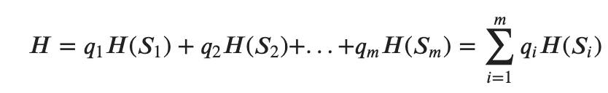
Entropy (2)
Each stage of a decision tree involves using an attribute to partition data into several subsets
We can calculate the entropy that results from partitioning a set of data in a certain way
if we partition our data S data into subsets S₁, S₂,…, S_{m}
containing proportions q₁, q₂,…, q_{m} of the data
then we can compute the entropy of the partition as a weighted sum
The ID3 algorithm (Iterative Dichotomiser) use a greedy approach selecting the attribute that yields minimum entropy

Slide 12
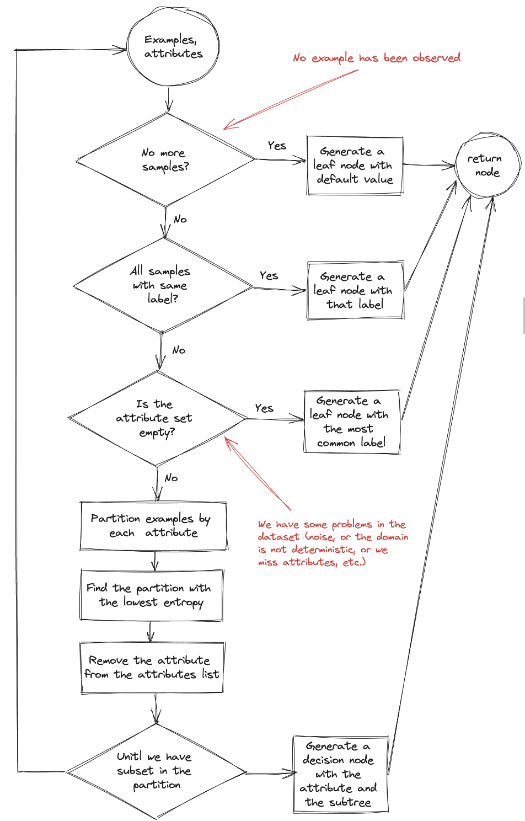
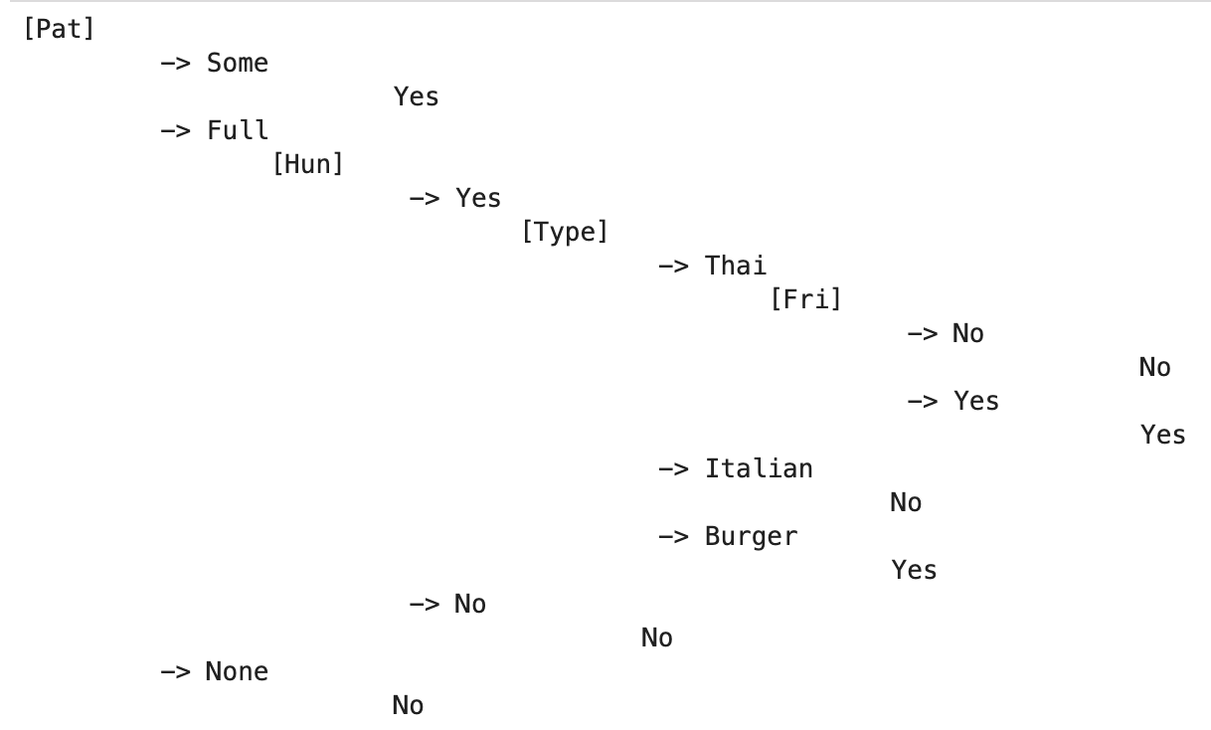
ID3 Algorithm (1)
It is greedy because it chooses the most immediately best option
There may be better trees with a worse-looking first move

Slide 13
ID3 Algorithm (2)
Notice that the set of examples is crucial for constructing the tree
learned tree is different from the one that we designed by hands
ID3 looks at the examples, not at the correct function
its decisions are consistent with all the examples, that’s all
for example, it has no reasons to tests for "raining" or "reservation”: it can classify all the examples without these attributes
It is also bound to make mistakes for cases with no examples
no cases with ”est" is 0-10 min, but the restaurant is full: it says not to wait when "hungry" is false, but a real user would certainly wait
with more training examples the learning program could correct this mistake

Slide 14
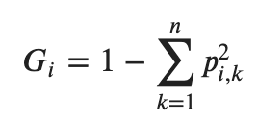
Gini
instead of the entropy we can use the gini notion
where p_{i,k} is the ratio of class k instances among the training instances in the i node
a node is defined as pure if all its training instances belong to the same class (gini=0)
Gini and Entropy measure can be used interchangeably
lead to similar trees
gini impurity is faster to compute
entropy tends to produce more balanced trees

Slide 15
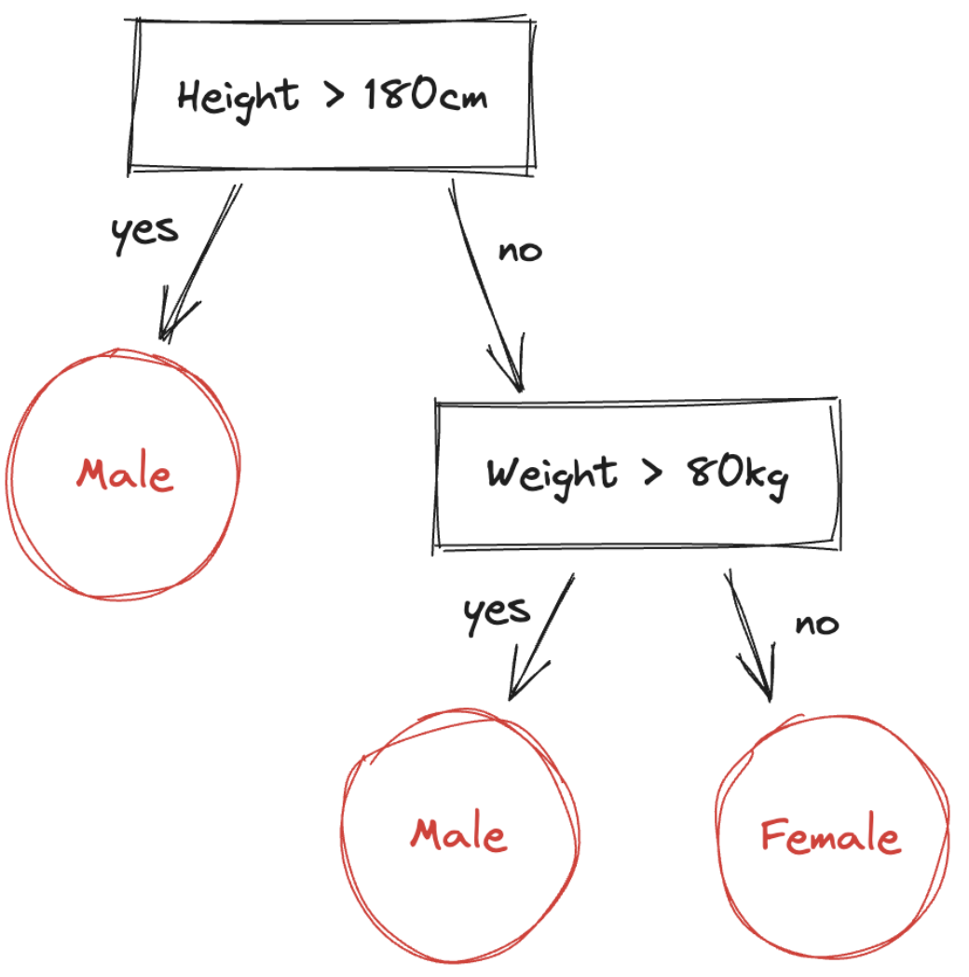
CART Algorithm (1)
What if we have numeric features?
We can split a set into two subsets using an attribute k and a threshold t_{k}
Example:
given a dataset with two inputs of height and weight
the output of sex as male or female will be classified as in the figure
We can search for the pair (k, t_{k}) that produces the purest subsets (or with minimum entropy)
weighted by their size
Classification and Regression Tree (CART) algorithm

Slide 16
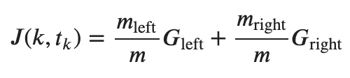
CART Algorithm (2)
The cost function it tries to minimize is:
G_{left/right} is the impurity of the left/right subset
m_{left/right} is the number of instances in the left/right subset
Algorithm:
split the training set in two
then splits the subsets using the same logic
then the sub-subsets, and so on, recursively
stops recursing once it reaches a maximum depth
or if it cannot find a split that will reduce impurity

Slide 17
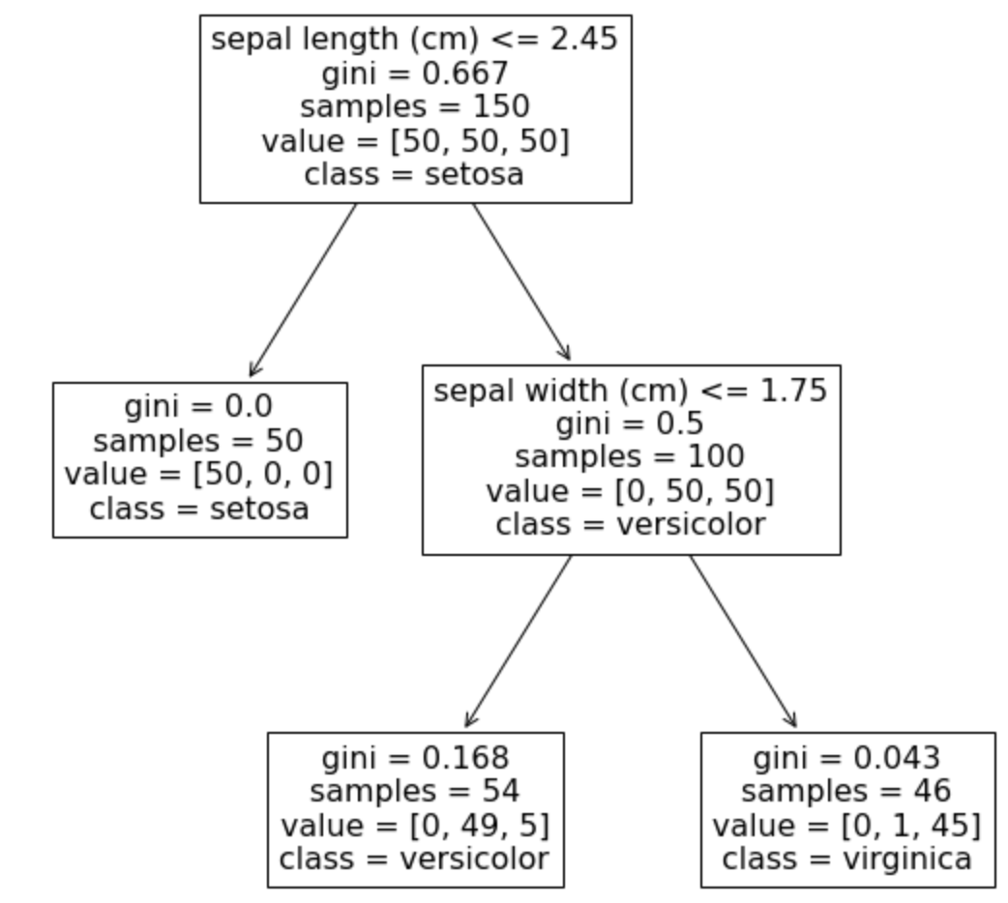
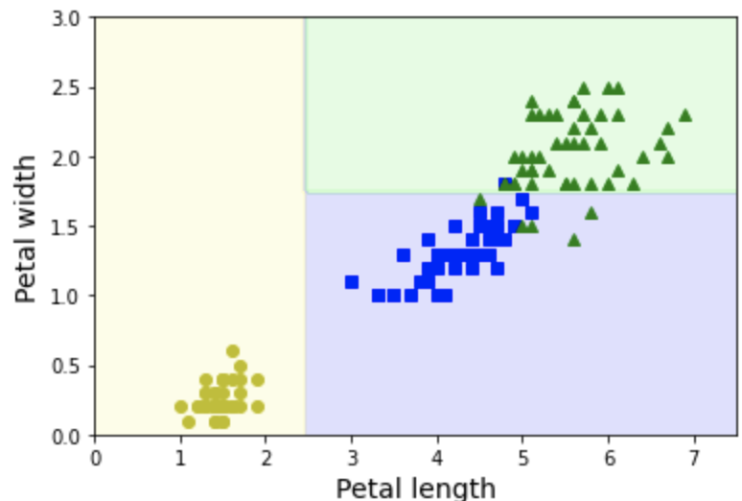
CART Algorithm (3)
We can make an example:
training a classifier for the Iris dataset
max depth = 2
Notice that the information of each nodes are:
parameter and the threshold considered
number of training instances of the node (samples)
number of training instances of each class (value)
measure of impurity (gini)
the class predicted (class)
We can draw the decision boundaries

Slide 18
CART Algorithm (4)
A Decision Tree can also estimate the probability that an instance x belongs to a particular class k
traverse the tree to find the leaf node for the instance x
returns the ratio of training instances of class k in this node
For example, check a flower whose petals are 5 cm long and 1.5 cm wide:

Slide 19
Non-parametric models
Decision Trees make very few assumptions about the training data
as opposed to linear models (which assume that the data is linear)
Such a model is often called a non-parametric model
not because it does not have any parameters (it often has a lot)
but because the number of parameters is not determined prior to training
the model structure is free to stick closely to the data
with high risk of overfitting
In contrast, a parametric model, such as a linear model, has a predetermined number of parameters
the degree of freedom is limited
reducing the risk of overfitting
but increasing the risk of underfitting

Slide 20
Regularization (1)
If left unconstrained, the tree structure will adapt itself to the training data, fitting it very closely, most likely overfitting it
suppose we try to predict when a roll of a dice will come up as 6 or not
of course, the correct tree should be a single node that says ”?”
however, we can run several experiments with several dice attributes (color, weight of the dice, time of the roll, and whether the experimenters had their fingers crossed)
the algorithm will learn any pattern it can find in the input
if there are 2 rolls of a 7gr blue dice with fingers crossed both with 6, then it may construct a tree that predicts 6 in that case!
A Decision Tree class has few parameters that restrict the shape of the tree:
the maximum depth of the tree
maximum number of leaf nodes
maximum number of features that are evaluated for splitting at each node

Slide 21
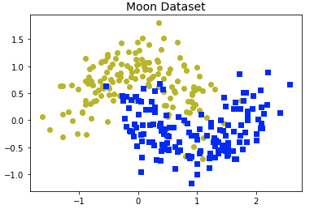
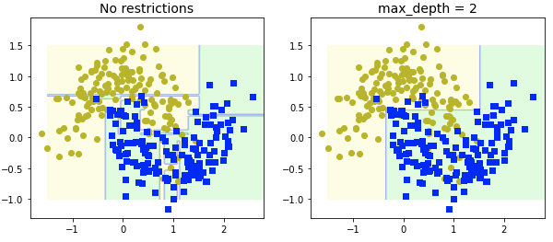
Regularization (2)
Moon dataset: a toy dataset for binary classification in which the data points are shaped as two interleaving half circles
We can train two trees
one with the default hyperparameters
one with max depth = 2
The model with default parameters is overfitting
The regularized model will probably generalize better

Slide 22
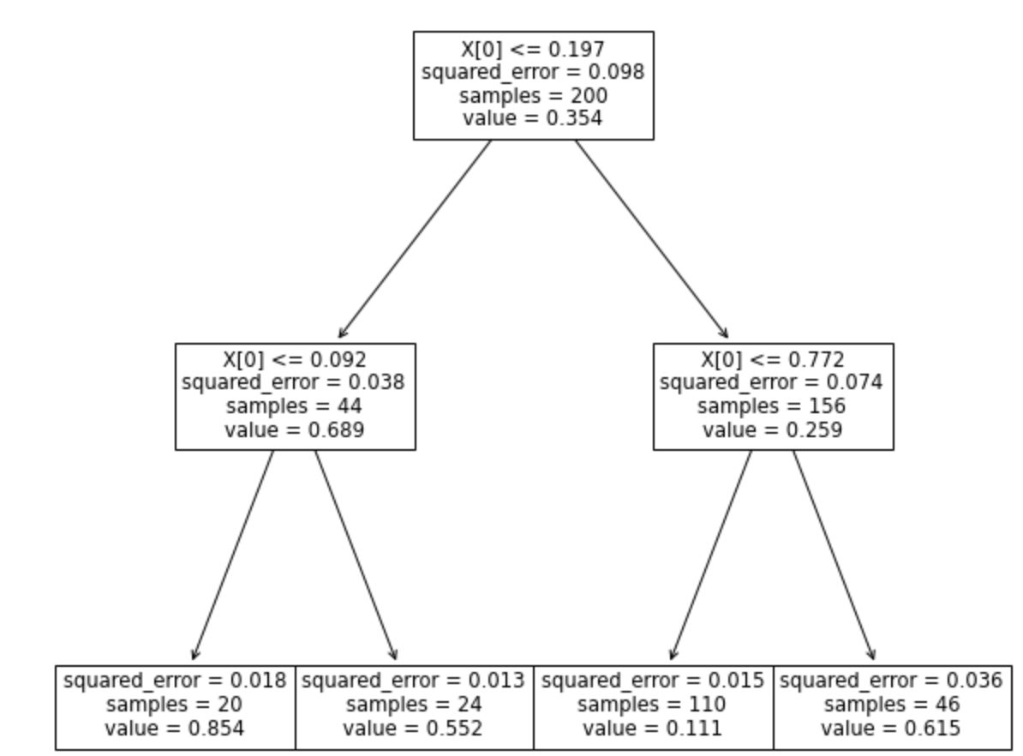
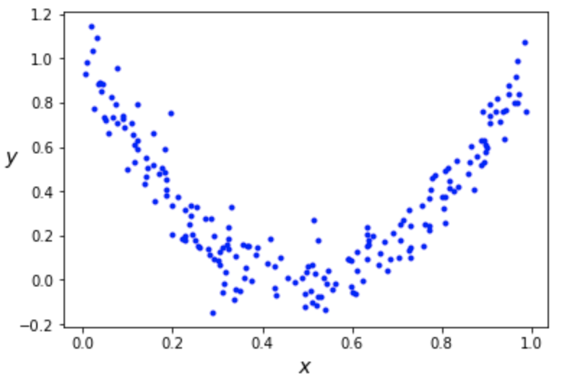
Regression (1)
Decision Trees are also capable of performing regression tasks
consider a a noisy quadratic dataset
build a regression tree with max depth=2
Instead of predicting a class in each node, it predicts a value

Slide 23
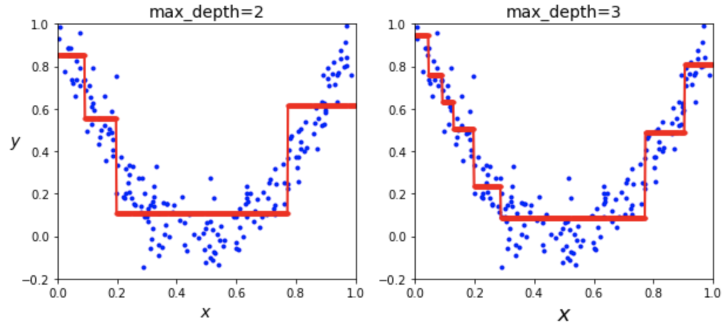
Regression (2)
To predict the value for a new instance (x=0.6)
traverse the tree from the root to a leaf node with the predicted value (0.111)
value is the average of the training instances (110) associated with the leaf node
the node shows also the mean squared error (0.015) over these instances
We can show the prediction also enlarging the max depth value:

Slide 24
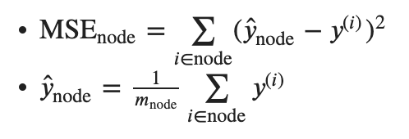

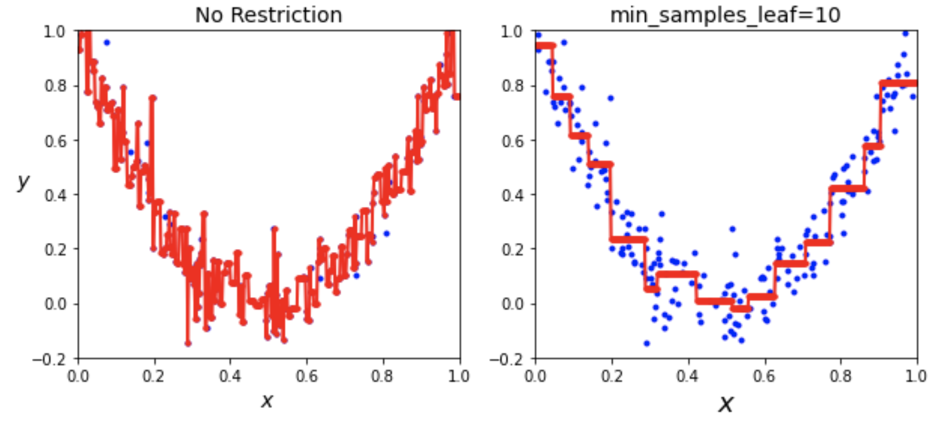
Regression (3)
Notice how the predicted value for each region is always the average target value of the instances in that region
the algorithm splits each region in a way that makes most training instances as close as possible to that predicted value
minimizing the MSE
Like for classification, Decision Trees are prone to overfitting:

Slide 25
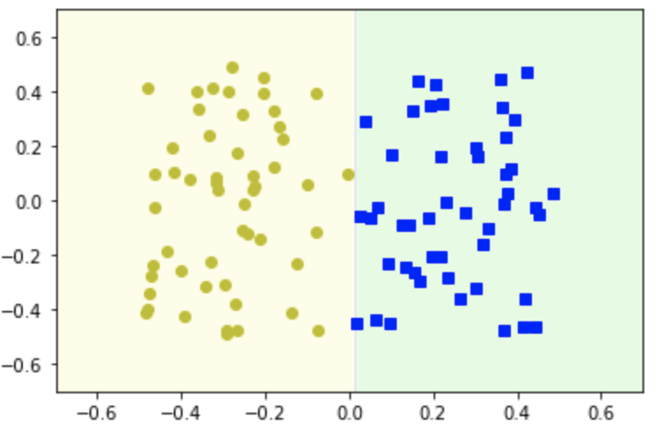
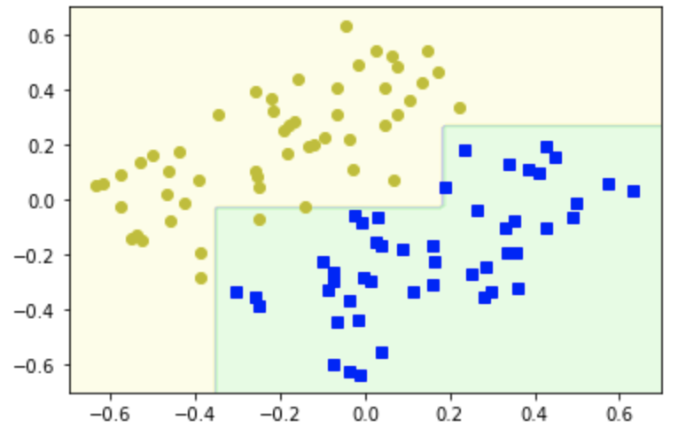
Instability
Decision Trees love orthogonal decision boundaries
all splits are perpendicular to an axis
this makes them sensitive to training set modification
For example, consider a simple linearly separable dataset
a Decision Tree can split it easily
but if we rotate the dataset, the decision boundary looks unnecessarily convoluted
although both trees fit the training set perfectly, it is very likely that generalize well
Decision Trees are sensitive to small variations in the training data
Random Forests can limit this instability…

Slide 26
Exercise
1 - Train and fine-tune a Decision Tree for the moons dataset: (a) use make_moons(n_samples=10000, noise=0.4) to generate the dataset; (b) use train_test_split() to split the dataset into a training and test set; (c) use grid search with cross-validation to find good hyperparameter values for a DecisionTreeClassifier; (d) measure the best model’s performance on the test set
2 - Grow a forest: (a) continuing the previous exercise, generate 1,000 subsets of the training set, each containing 100 instances selected randomly; (b) train one Decision Tree on each subset, using the best hyperparameter values found in the previous exercise, evaluate these 1,000 Decision Trees on the test set (since they were trained on smaller sets, these Decision Trees will likely perform worse than the first Decision Tree); (c) Now comes the magic: for each test set instance, generate the predictions of the 1,000 Decision Trees, and keep only the most frequent prediction; (d) evaluate these predictions on the test set: you should obtain a slightly higher accuracy than your first model!

